Slide 1


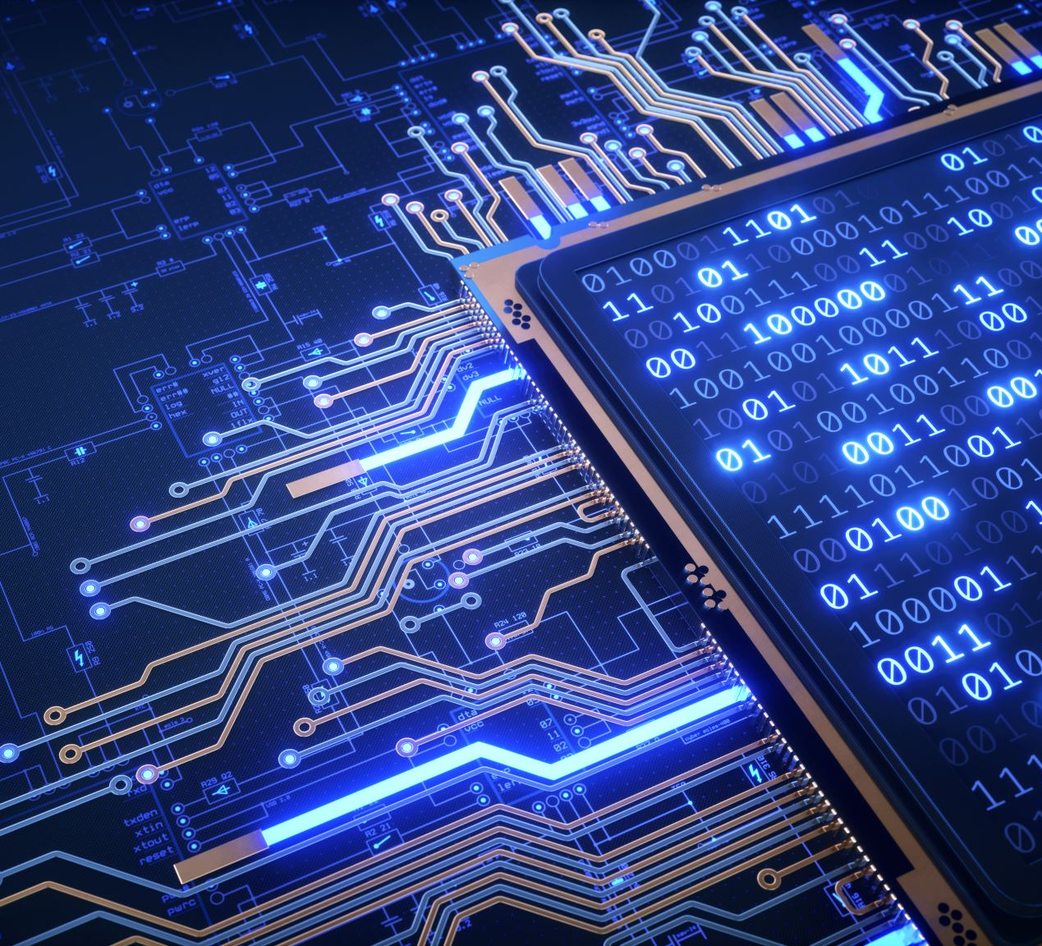

Cryptographic protocol analysis and verification
Project Sponsor: Ed Ziegler
TEAM ARMORWARE:
Mostafa Galib
Aj Shah
Sreevidhya Ravindran
Major Liu
Zoraida Vences

Slide 2
PROJECT DESCRIPTION:
CPSA
We will use Cryptographic Protocol Shapes Analyzer (CPSA) to model and analyze 5G-EAP-TLS protocol
CPSA takes a protocol definition and a partial execution as input
Produces descriptions (shapes) of possible executions of a protocol to reveal structural flaws
What protocol are we analyzing?
We will be analyzing the security properties of 5G-EAP-TLS authentication protocol
5G network is the next generation of mobile network

Slide 3
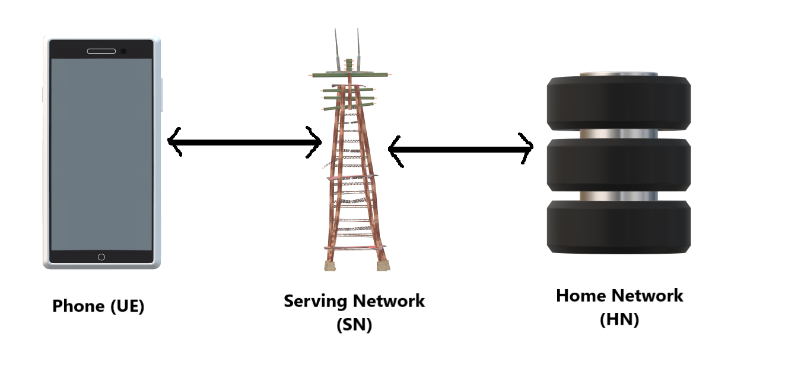
A brief overview of 5g:
The 5G network architecture can be categorized into three entities:
User Equipment (UE) which contains the USIM (Universal Subscriber Identity Model) comprised of four elements:
  Subscription Permanent Identifier (SUPI), which is a unique and permanent subscriber identity
  Public key of the home network
  A long-term secret symmetric key, shared between the subscribers and their corresponding home network
  Sequence Number
Serving Network (SN) which acts as a middleware during the authentication process
Home Network (HN) which is responsible for user authentication and which contains the following elements:
  Authentication Server Function (AUSF), which performs authentication with the UE
  Unified Data Management (UDM) to assist in functions related to data management

Slide 4
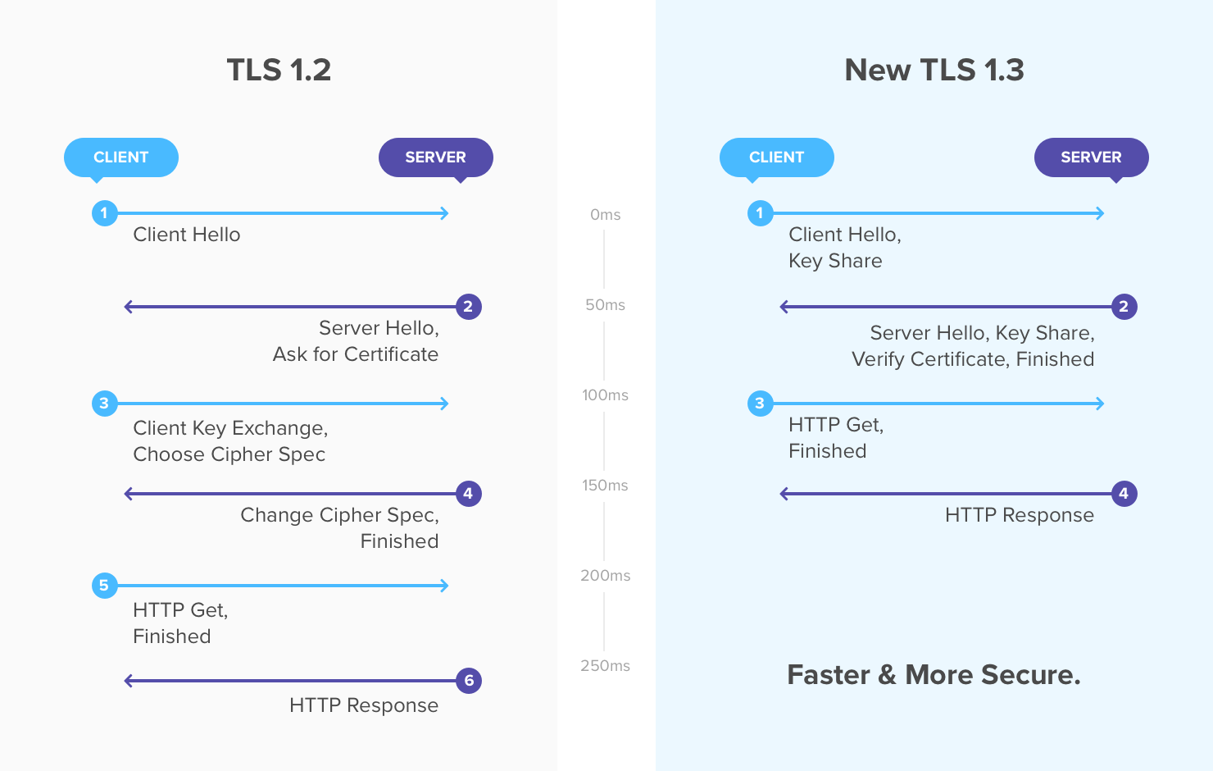
Transport layer security

Slide 5
Formal verification of 5g-eap-tls 1.2 protocol
Modeling Choice
We will consider two roles: UE and NW (a composition of Serving Network and Home Network)
  We assume that the connection is secure between the serving network and home network because it is typically a wired link (and assumed to be secure)
We will model the protocol according to the Dolev-Yao model:
  Cryptography is assumed to be perfect; a message can only be decrypted by someone who has the right key
  Messages are assumed to be abstract terms (either the intruder learns the complete message because of having the key or the intruder learns nothing at all)
  Network is assumed to be under full control of the adversary, anything transmitted over the network can be seen by the adversary

Slide 6
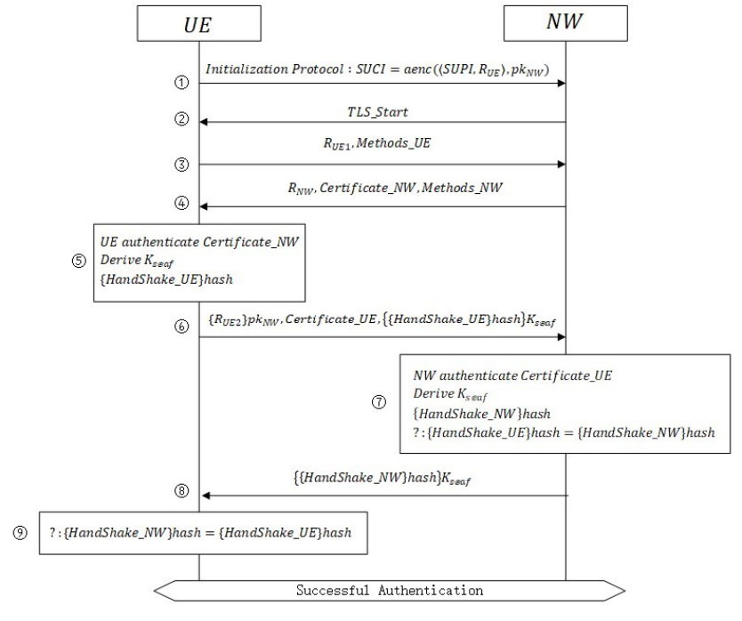
Formal verification of 5g-eap-tls 1.2 protocol
UE sends SUCI, which contains the SUPI and a nonce R_{UE} encrypted with NW’s public key (pk_{NW})
NW replies with TLS_Start message to initiate the TLS process
UE generates another nonce, R_{UE1} and sends it to NW with a constant string Methods_UE to determine methods for authentication
NW generates a nonce R_{NW} and sends it to UE with NW’s certificate (Certificate_NW) and a constant string Methods_NW to indicate the authentication method

Slide 7
Formal verification of 5g-eap-tls 1.2 protocol
Upon successful authentication of NW’s certificate:
  UE generates a new nonce R_{UE2} to compute the session key (K_{seaf})using R_{UE1}, R_{NW}, and R_{UE2}. The hash of HandShake_UE is also computed.
UE sends R_{UE2} encrypted with the public key of NW along with UE’s certificate (Certificate_UE) and hash of Handshake_UE encrypted with the session key
NW authenticates the certificate of UE and upon successful authentication:
  NW generates the session key after decrypting R_{UE2}
  NW computes the hash of Handshake-NW and if it is equal to the hash of Handshake-UE, then it claims the authentication to be successful and proceeds to the next step

Slide 8
Formal verification of 5g-eap-tls 1.2 protocol
NW sends the hash of HandShake_NW string encrypted with the session key to UE
UE compares the hash of HandShake_NW to the hash of HandShake_UE. If they are equal, then authentication is successful

Slide 9
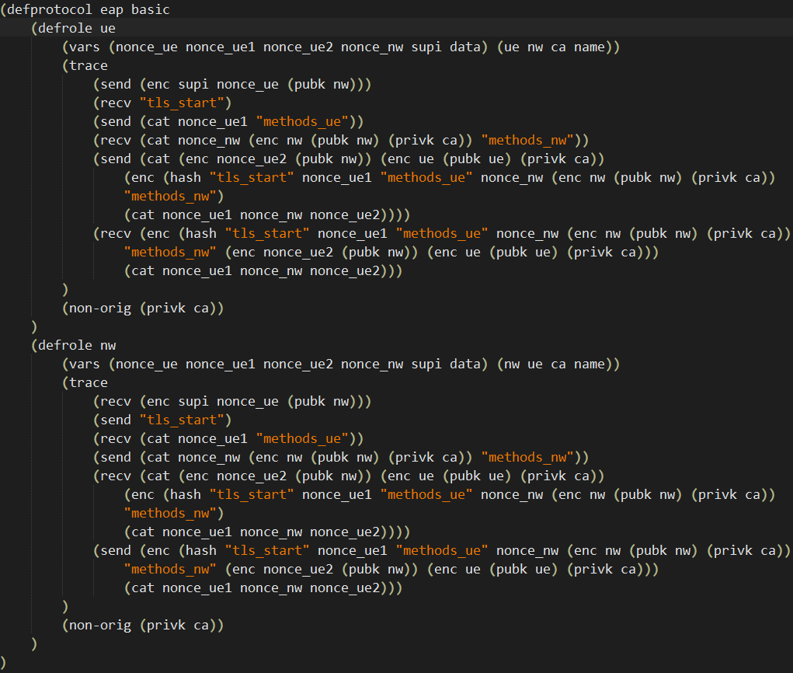
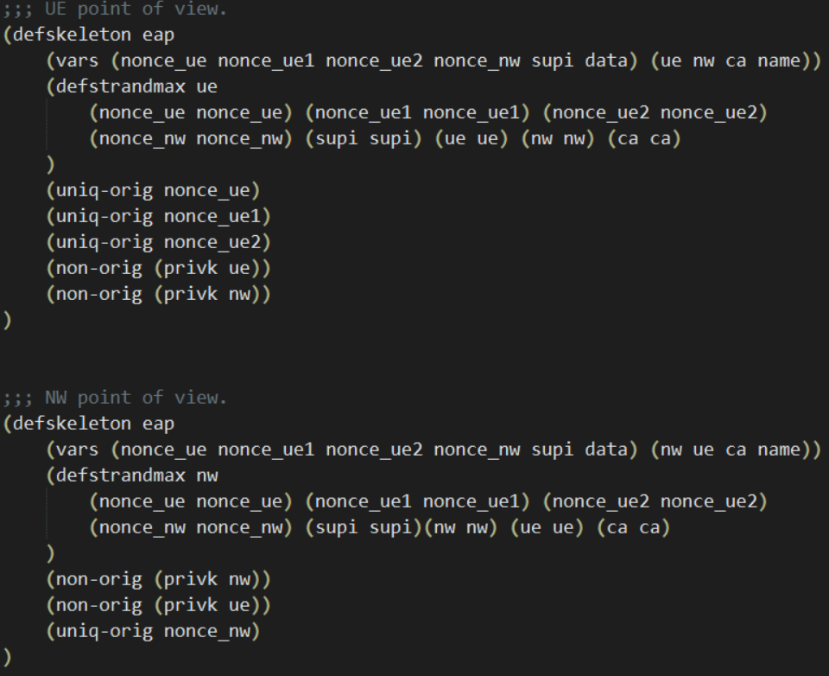
5G-EAP-TLS 1.2 CPSA Code

Slide 10


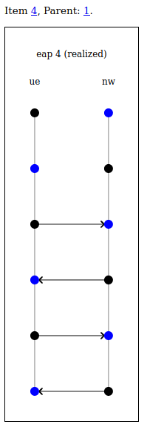
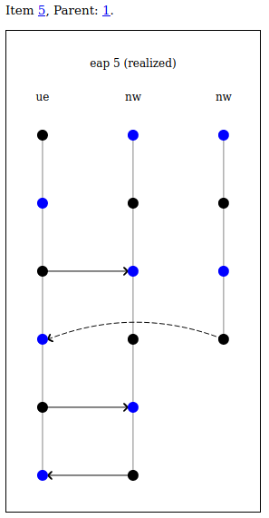
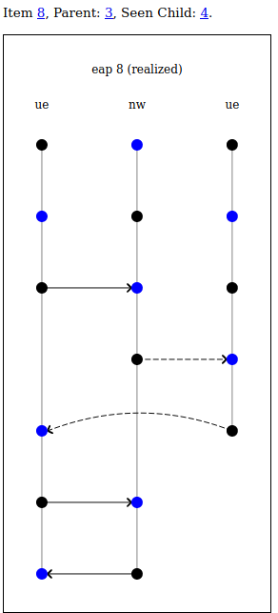
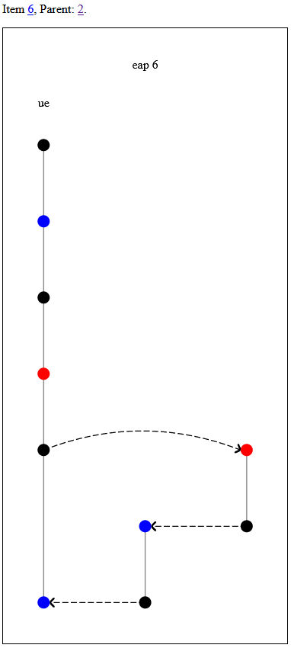
5G-EAP-TLS 1.2 Analysis

Slide 11
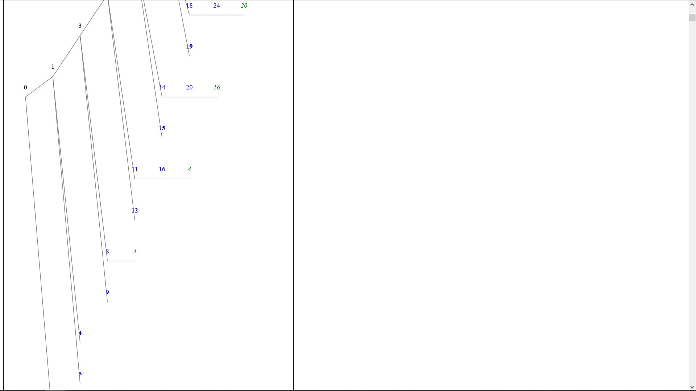
5G-EAP-TLS 1.2 Analysis
Based on the shapes and realized skeletons generated from our CPSA model our implementation of the 5G-EAP-TLS protocol appears to be secure.
The most important part of this protocol is the security of the session key that is generated. Despite how many UE and NW entities are generated, the last two messages that are exchanged using the session key are always between the first instances of UE and NW.
Furthermore, some instances of the tree will lead back to the expected procedure (child 4)
Seen Child (links to elsewhere in the tree with live children)

Slide 12
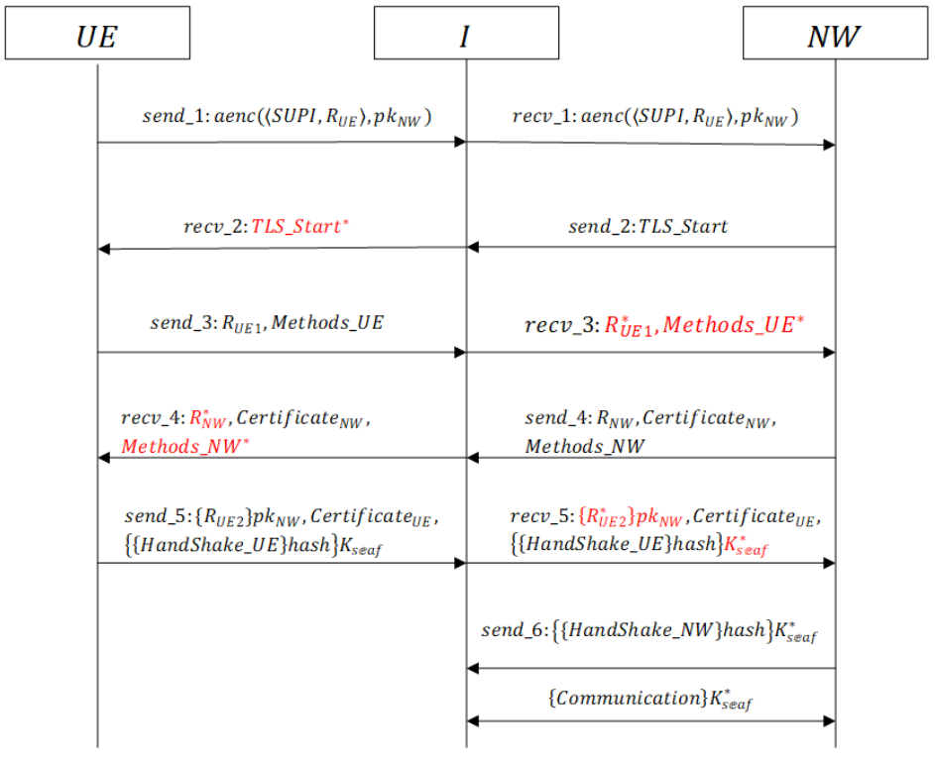
5G-EAP-TLS 1.2 Analysis
It is interesting that our CPSA implementation of the 5G-EAP-TLS protocol did not encounter the MiTM attack.
A man in the middle attack could work in theory as the security of the session key could be compromised as R_{UE1} and R_{NW} are sent in the clear and R_{UE2} can be spoofed by the adversary.

Slide 13
Challenges
Learning how to use CPSA to create models
Generating the .shapes file (using step limits and bounds)
Translating some of the elements from the model into CPSA
  HandShakes (UE and NW)
  Representing some of the data as literals instead of variables
  Certificates as encrypted data instead of string
Analyzing the realized skeletons and shapes
Implementing the protocol using TLS 1.3

Slide 14
Future Work
Continue Analysis on the 5G-EAP-TLS 1.3 Protocol
  More testing of our current model to verify its accuracy.
  Extensive analysis of the shapes and realized skeletons once an accurate model is developed.
Analysis of other EAP-TLS Conversations
  EAP-TLS server rejection of ClientHello
  EAP-TLS unsuccessful server authentication
  EAP-TLS unsuccessful client authentication
  EAP-TLS without peer authentication
  EAP-TLS with Hello Retry Request
  EAP-TLS ticket establishment
  EAP-TLS resumption

Slide 15
Thank you!
Any QUESTIONS?

